Slide 1
Multi-label Classification of Stack Overflow Questions using OneVsRest Classification Paradigm
Pramod Kumar gudipati
Keerthi Korivi

Slide 2
Outline
Problem Statement
Background
Dataset
Methodology
Implementation
Results
Future Work
References

Slide 3
Problem Statement
To Q&A forums like Stack Overflow and Quora, tagging questions is an important aspect for a good user experience as it helps in easy retrieval of the information. Also, organizing these posts will be a lot easier
However, manually tagging a post is a burden for users which degrades the overall user-experience
We implemented a multi-label classification system that predicts tags to questions using OneVsRest paradigm to enhance user experience

Slide 4
Background
Classification is the process of identifying a correct class label for a given input. Some examples of classification tasks are:
Decided whether an email is spam or not is a binary classification, since it has only two possible outcomes i.e. either spam or not spam
Deciding what topic a newspaper article belongs to is a multi-class classification, since it has more than two possible outcomes such as sports, education, health, politics etc.
Two major approaches of multi-label classification are:
Problem Transformation - transforms the multi-label classification problem into several single-label classification problems
Adaptive Algorithms - uses single-label classifiers like SVM, Random Forest, decision tree etc., to handle multi-label data

Slide 5
Data Set
Stack overflow dataset provided for one of the kaggle competitions
The dataset contains about 150000 records of which we have subsampled the dataset to 50000 records
Each record contains the following columns: id, title, body, tags. Each record can have multiple tags
List of most frequent tags considered: java, android, JavaScript, multithreading, mysql, swing, exception, eclipse, python, django, dictionary, matplotlib, numpy, scala and functional-programming

Slide 6
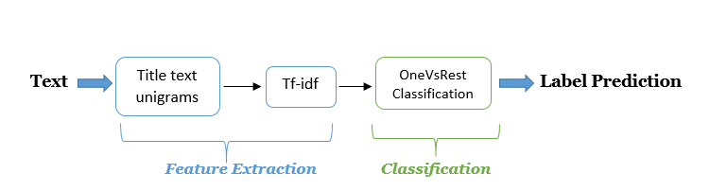
Methodology
Two important steps in our methodology are:
Feature Extraction
Classification
Evaluation Criteria
F1 Score

Slide 7
Implementation
Feature Extraction step
term frequency–inverse document frequency(tf-idf) generation for title text unigrams using StringToWord filter and tf-idf vectorizer for MEKA and Scikit-learn respectively
Classification Step using OneVsRest approach
Scikit-learn
Stochastic Gradient Descent(SGD) classifier
Mulan API using MEKA GUI interface
Stochastic Gradient Descent(SGD) classifier
Sequential Minimal Optimization(SMO) classifier
Naïve Bayes classifier

Slide 8




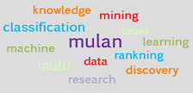
Tools
PyCharm is an integrated development environment used for programming in Python
Numpy provides support for large, multi-dimensional arrays and matrices along with a large library of high-level mathematical functions
Matplotlib is a plotting library for python and its numerical mathematics extension Numpy
Scikit-learn is a machine learning library for python and features various classification, regression and clustering algorithms
MULAN is an open source java library for learning from multi-label datasets
MEKA is an extension to WEKA and also a wrapper to the MULAN framework

Slide 9
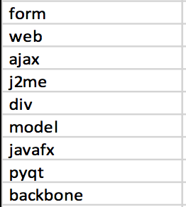
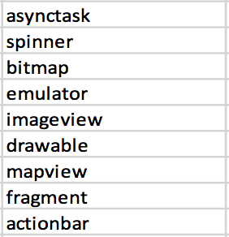
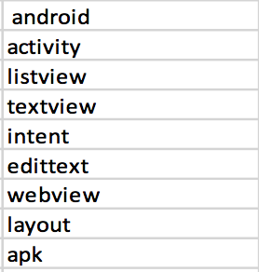
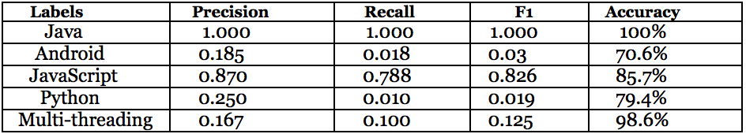
Results
List of most important features identified
Performance measures of the most common labels
Performance measures of different classifiers in MEKA
Classifier | Precision | Recall | F1 | Accuracy
SGD | 0.179 | 0.339 | 0.758 | 70.4%
SMO | 0.18 | 0.338 | 0.768 | 71.8%
Naïve Bayes | 0.133 | 0.212 | 0.711 | 61.8%

Slide 10
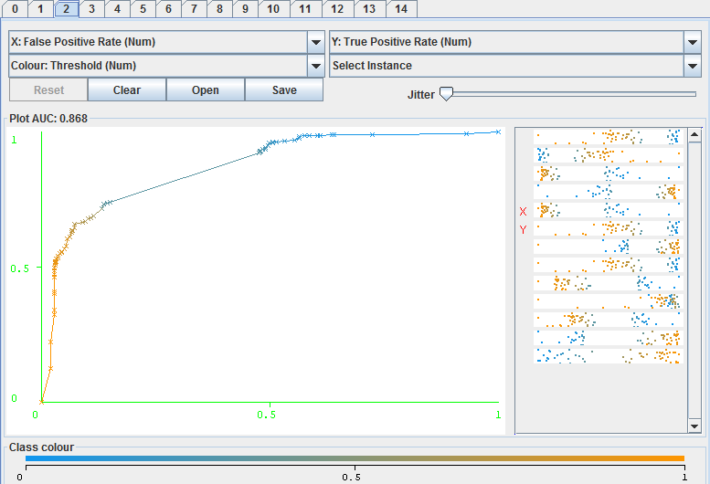
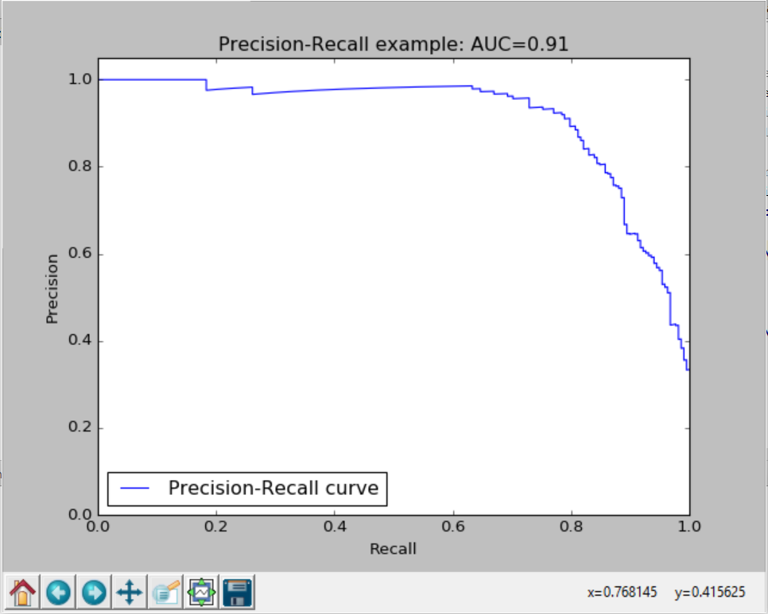
Results Contd..
ROC curve for javascript label
Precision-Recall Curve for 10000 using SGD classifier

Slide 11
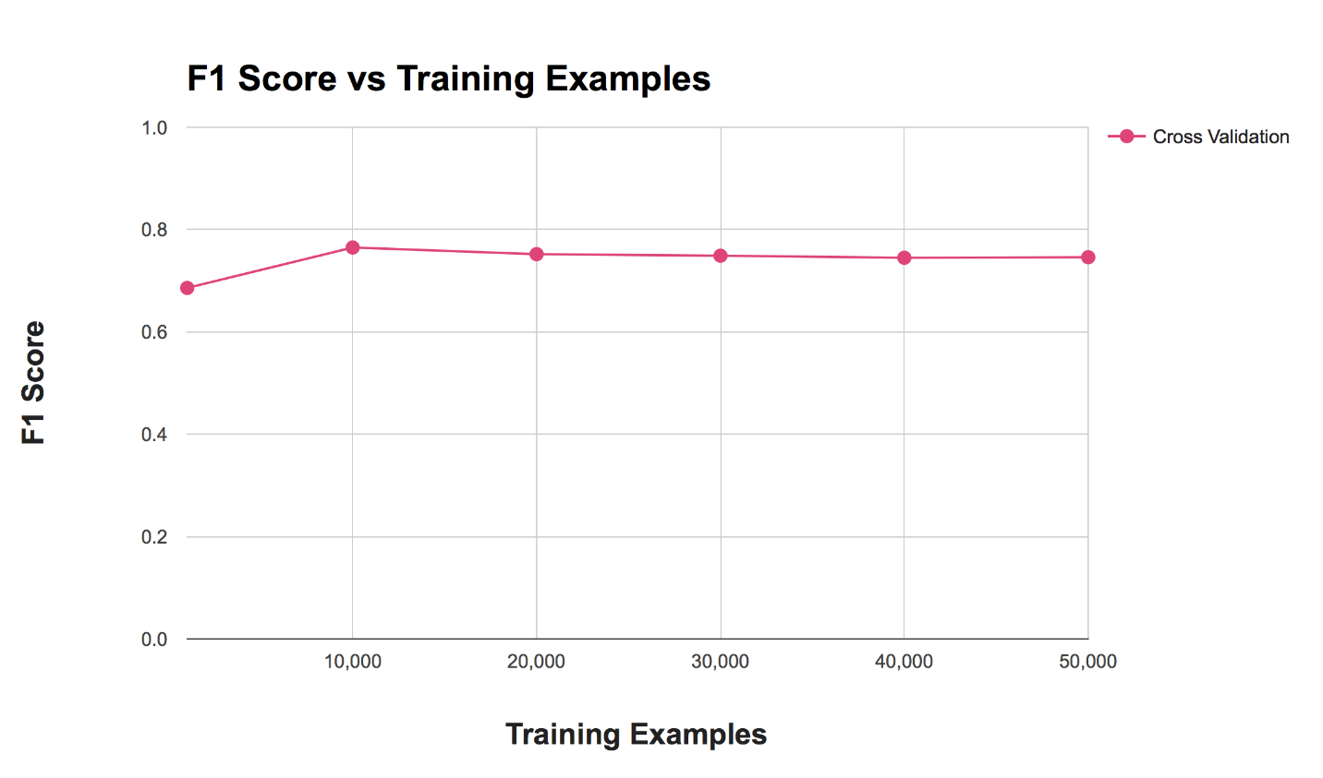
Results Contd..
Measure of variation in F1 score with incremental count of 10000 for questions

Slide 12
Future work
Ensuring similar counts of questions for each label in the training data can improve the overall accuracy of the classifier
Analyzing the effect of using n-grams on overall accuracy of classifier
Considering, Title as a baseline approach and verifying the accuracy by augmenting body text with the title text as an incremental approach.
Considering a programming dataset, focusing on keywords in code fragments can improve tag prediction accuracy

Slide 13
References
https://en.wikipedia.org/wiki/F1_score
http://www.jatit.org/volumes/Vol84No3/13Vol84No3.pdf
http://mulan.sourceforge.net/
http://meka.sourceforge.net/
https://www.kaggle.com/c/facebook-recruiting-iii-keyword-extraction
http://jmlr.csail.mit.edu/proceedings/papers/v28/bi13.pdf
http://www.jmlr.org/proceedings/papers/v9/dekel10a/dekel10a.pdf
http://lpis.csd.auth.gr/publications/tsoumakas-ijdwm.pdf
http://www.clei.org/cleiej/papers/v14i1p4.pdf
http://people.oregonstate.edu/~sorowerm/pdf/Qual-Multilabel-Shahed-CompleteVersion.pdf
http://scikit-learn.org/stable/auto_examples/plot_multilabel.html
https://www.youtube.com/watch?v=nNDqbUhtIRg
http://stanford.edu/~meric/files/cs229.pdf

Slide 14
Thank You!!

